Slide 1
Learning in Information Retrieval (1)

Slide 2
Outline
Learning in IR – introduction/overview
Some applications
Case Study 1: Genetic Algorithms in IR
Case Study 2: Genetic Programming in IR
Available Software
Summary

Slide 3
Motivations
Many real-world problems are complex and it is difficult to specify (algorithmically) how to solve many of these problems.
Learning techniques are used in many domains to find solutions to problems that may not be obvious/clear to human users.
"How can computers learn to solve problems without being explicitly programmed?“ A. Samuel (1959)

Slide 4
Many applications in IR including …
Classification
Clustering
Neural network models
Learning user models
Learning optimal means to combine sources
Learning to rank
and many others …

Slide 5
In general …
Machine learning involves searching a large space of potential hypotheses or potential solutions …
… to find the hypotheses/solution that best explains or fits
a set of data and
any prior knowledge
or is the best solution.
or can say … learns if it improves its performance.

Slide 6
Machine learning techniques require a training stage before the learned solution can be used on new previously unseen data .
The training stage consists of a data set of examples which can be:
  Labelled (supervised training)
  Unlabelled (unsupervised training)
An additional data set must also be used to test the hypothesis/solution.

Slide 7
Symbolic
knowledge is represented in the form of symbolic descriptions of the learned concepts, e.g., production rules or concept hierarchies
Sub-symbolic
Knowledge is represented in a sub-symbolic form not readable by a user, e.g., in the structure, weights and biases of the trained network

Slide 8
Learning approaches have become more and more prevalent in information retrieval in the past few years.
New workshops, conference, application domains, systems/packages, approaches
“Learning to Rank”

Slide 9
Many examples of learning in IR:
Feedback mechanisms; clustering;
Sentiment analysis using neural networks
(Santos & Gatti, 2014)
A Language Modeling Approach to Personalized Search Based on Users’ Microblog Behavior (Younus et al, 2013)
Learning to Extract Local Events from the Web
(Foley et at., 2015)
Learning to Reweight Terms with Distributional Representations
(Zheng, Callan, 2015)
... and many many more ..

Slide 10
Genetic Algorithms
Inspired by Darwinian theory of evolution.
At each step of algorithm, the best solutions are selected while the weaker solutions are discarded.
Uses operators based on crossover and mutation as the basis of the algorithm to sample space of solutions.

Slide 11
Create random population
while solution not found:
Calculate fitness of each individual
Select population for reproduction:
Perform crossover
Perform mutation
Repeat
Genetic Algorithms Steps
Reproduction
Reproduction
Crossover
Crossover
Mutation
Mutation
population
population
Select Population
Select Population
Calculate Fitness
Calculate Fitness

Slide 12
Representation
Genotype
Phenotype
Traditionally, solutions are represented in binary as strings of 0s and 1s
encode
phenotype
genotype
decode
Fitness
Need an an evaluation function which will discriminate between better and worse solutions.

Slide 13
Crossover
Example of one-point crossover:
11001011 and 11011111 gives 11001111 and 11011011
N-point:
1101101101 and 0001001000
gives:
1101001100 and 0001101001

Slide 14
Mutation
Occurs in the GA at a much lower rate than the crossover.
Important in order to add some diversity to the population in the hope that new better solutions are discovered and therefore it aids in the evolution of the population.
Example of mutation:
11001001 => 10001001

Slide 15
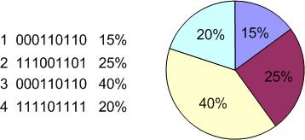
Selection
Roulette Wheel Selection:
Each sector in wheel is proportional to individual’s fitness. Selects n individuals by means of n roulette “turns”. Each individual is drawn independently.
Tournament Selection:
A number individuals are selected at random with replacement from the population
The individual with the best score is selected
This is repeated n times.

Slide 16
Issues:
Choice of representation for encoding individuals
Definition of fitness function
Definition of selection scheme
Definition of suitable genetic operators
Setting of parameters:
size of population
number of generations
probability of crossover
probability of mutation
etc.

Slide 17
Genetic Programming
Genetic Programming applies the approach of the genetic algorithm to the space of possible computer programs.
“Virtually all problems in artificial intelligence, machine learning, adaptive systems, and automated learning can be recast as a search for a computer program. Genetic programming provides a way to successfully conduct the search for a computer program in the space of computer programs.”
Koza

Slide 18
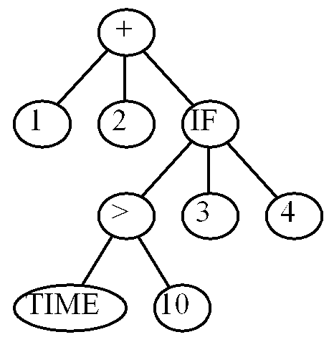
Representation
A random population of solutions is created which are modelled in a tree structure with:
operators as internal nodes
operands as leaf nodes
(+ 1 2 (IF (> TIME 10) 3 4))

Slide 19
Crossover
+
+
+
+
/
/
/
C
C
C
A
/
B
B
~
B
~
B
B
C
A
A
+
+
+
+
/
/
/
C
C
C
~
A
~
B
B
B
/
A
A
B
B
C

Slide 20
Mutation
+
A
/
B
B
C
+
A
*
B
B
C

Slide 21
Case study 1: application of genetic algorithms to IR
The effectiveness of an IR system is dependent on the quality of the weights assigned to terms in documents.
We have seen heuristic based approaches and their effectiveness and we’ve see axiomatic approaches that could be considered.
Why not learn the weights?
We have a definition of relevant and non-relevant documents; can use MAP or precision@k as fitness

Slide 22
Case study 1: GA approach
Each genotype can be a vector of length N (the size of the lexicon).
Set all rates randomly initially.
Run system with a set of queries to obtain fitness; select good chromosomes; crossover; mutate.
Effectively searching landscape for weights to give good ranking
Several examples: Etzioni (one of the first).

Slide 23
Case study 2: application of genetic programming to IR
Evolutionary computing approaches:
- evolutionary strategies
- genetic algorithms
- genetic programming

Slide 24
Why Genetic Programming for IR?
(Cummins, 2007)
Produces a symbolic representation of a solution which is useful for further analysis.
Using training data, MAP can be directly optimised (i.e. used as the fitness function)
Solutions produced are often generalisable as solution length (size) can be controlled

Slide 25
Genetic Programming and IR – previous approaches
Oren (2002):
  Non-primitive terminals, small collections, not generalisable.
Fan et al. (2002-2005):
  Mostly primitive terminals, works well for short queries only
Trotman (2005):
  Primitive terminals, seeded initial population, solutions more general than those previously obtained
Almeida et al. (2007):
  Non-primitive terminals, ‘memorises’ training data, not generalisable, ignores most of the search space, biases towards variations of already known functions, no analysis of ‘evolved’ solutions

Slide 26
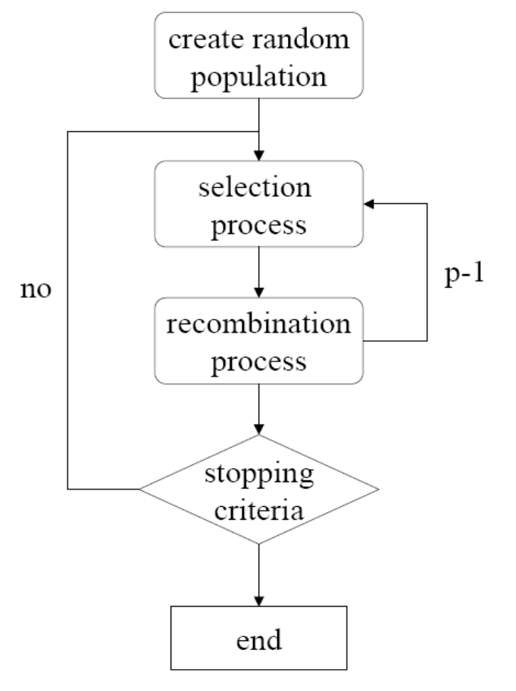
Genetic Programming Flow
Trees created at random (usually)
Evaluate how each performs
in its environment (using a fitness function)
Selection occurs based on fitness
(tournament selection)
Crossover of selected solutions
to create new individuals
Repeat until population is replaced
Repeat for N generations

Slide 27
Anatomy of a term-weighting scheme
Typical components of term weighting schemes:
  - term frequency aspect
  - ‘inverse document’ score
  - normalisation factor
Decompose the search space accordingly

Slide 28
Why separate learning into stages?
The search space using primitive measures and functions is extremely large.
Reducing the search space is advantageous – efficiency increased
It eases the analysis of the solutions produced at each stage.
Comparisons to existing benchmarks at each of these stages can be used to determine if the GP is finding novel solutions or variations on existing solutions
It can then be identified from where any improvement in performance is coming.

Slide 29
Learn each of the three parts in turn
Learn a term-discrimination scheme (i.e. some type of idf) using primitive global measures.
  8 terminals and 8 functions
  T = {df, cf, N, V, C, 1, 10, 0.5}
  F = {+, *, /, -, square(), sqrt(), ln(), exp()}
Use this global measure and learn a term-frequency aspect.
  4 terminals and 8 functions
  T = {tf, 1, 10, 0.5}
  F = {+, *, /, -, square(), sqrt(), ln(), exp()}
Finally, learn a normalisation scheme.
  6 terminals and 8 functions
  T = {dl, dl_{avg}, dl_{dev}, 1, 10, 0.5}
  F = {+, *, /, -, square(), sqrt(), ln(), exp()}

Slide 30
Three-Stages
GP process
8 functions
6 norm.
terminals
w₃
GP process
w₃*tff
8 functions
8 global
terminals
GP process
8 functions
4 tf
terminals
w₃*ntf

Slide 31
Details of Learning Approach
7 global functions were developed on ~32,000 OHSUMED documents
  All validated on a larger unseen collection and the best function taken
  Random population of 100 for 50 generations
  Fitness function used was MAP
7 tf functions were developed ~ 32,000 LATIMES documents
  All validated on a larger unseen collection and the best function taken
  Random population of 200 for 25 generations
  Fitness function used was MAP
7 normalisation functions were developed 3 x ~10,000 LATIMES documents
  All validated on a larger unseen collection and the best function taken
  Random population of 200 for 25 generations
  Fitness function used was average MAP over the 3 collections

Slide 32
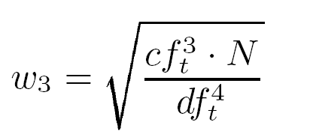
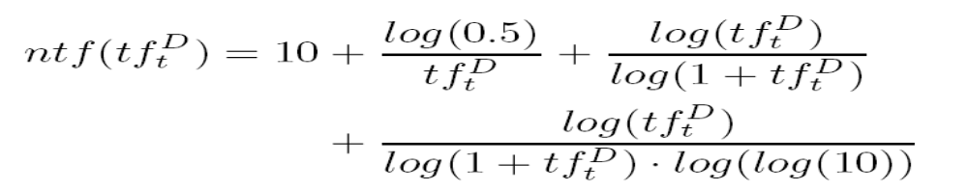
Analysis (1)
Global function (w₃) always produces a positive number
Based on w₃ the following term-frequency factor was learned

Slide 33
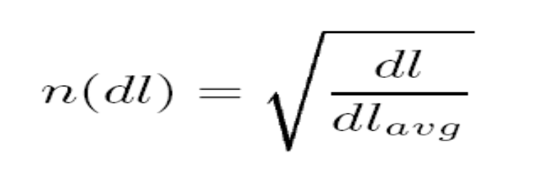
Analysis (2)
The following normalisation scheme was found on several independent runs of the GP
The best 6 (of the 7) schemes contained a sub-linear normalisation function shape.

Slide 34
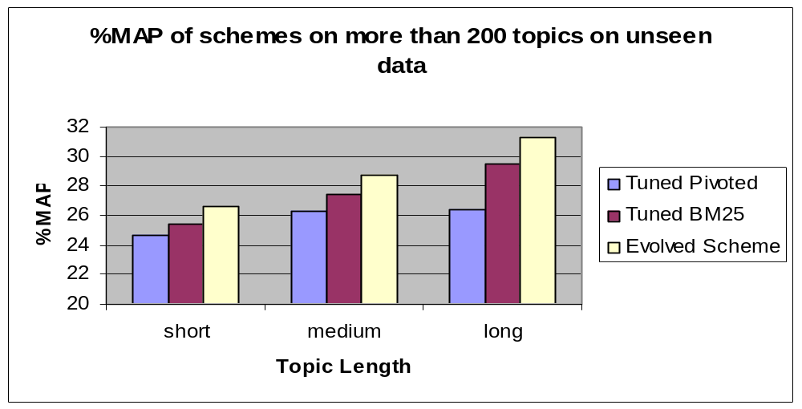
Results on Unseen Test Data
The increase over the tuned BM25 scheme is significant (p<0.05) albeit small for some query lengths

Slide 35
Summary of GP applied to IR
Empirical evaluations shows that the evolved scheme outperforms a tuned pivoted normalisation scheme and a tuned BM25 scheme.
The evolved scheme is also nonparametric.
The use of primitive atomic measures and basic function types is crucial in allowing the shape of term-weighting functions to evolve.

Slide 36
Learning to rank: software
Letor
Developed by Microsoft research asia
Package with built in functions and terminals, data sets and learning mechanisms

Slide 37
Letor
OHSUMED, MEDLINE subset for IR
– 350K records from 270 medical journals from 1981-1991
– Title, abstract, MeSH indexing terms, author, source,
publication type
– 106 queries
– Judgments of definitely, partially, and not relevant
– 16,140 query-document pairs with judgments
.GOV collection
– 1 million records, with 11 million links
– 125 queries

Slide 38
Letor
Very large list of built-in features (mainly non-primitive)
Includes high level features (page rank of a page, tf-idf score, bm25 etc.)
Currently several groups using letor
Issue surround the correct choice of primitives

Slide 39
Overall summary
Many difficult problems in IR, with many
Parameters and many unknown interactions
between these parameters (e.g. term weighting,
and many others)
Learning mechanisms can be used to search this
huge space in a useful manner
Shown to arrive at solutions that outperform the
best human designed ones
Much success in classical IR, feedback, expert search etc.

